Slide 1
Min and Max Width

Slide 2
Agenda
Min and Max Width
Sample output
Min and Max Width implementation

Slide 3
Min and Max Width
We can set min and max width for the html tags.
When your browser is in maximize mode the width of the tags will not be beyond the given max width.
When you browser is small in size, the width of the tags will not be less than the given min width.
If we try to reduce the size of screen beyond the min width, the page will overflow and we can see a horizontal scroll bar on the web page.
Syntax:
min-width: 400px;
max-width: 600px;

Slide 4
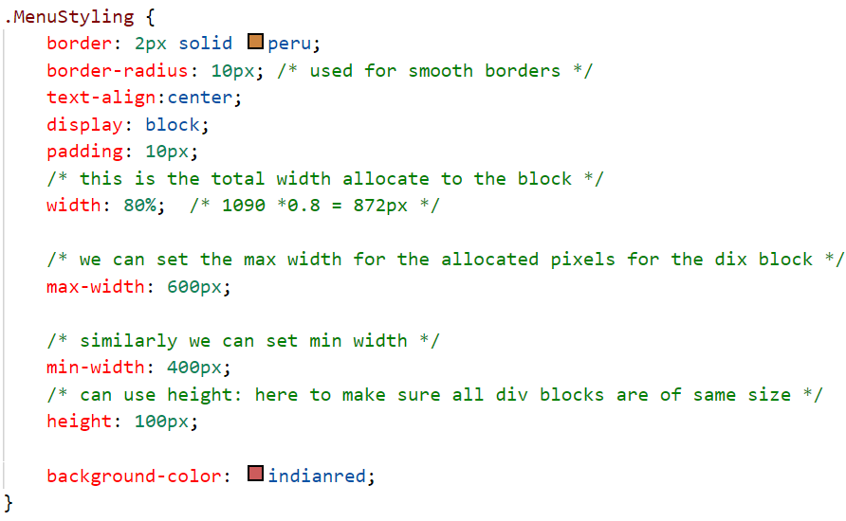
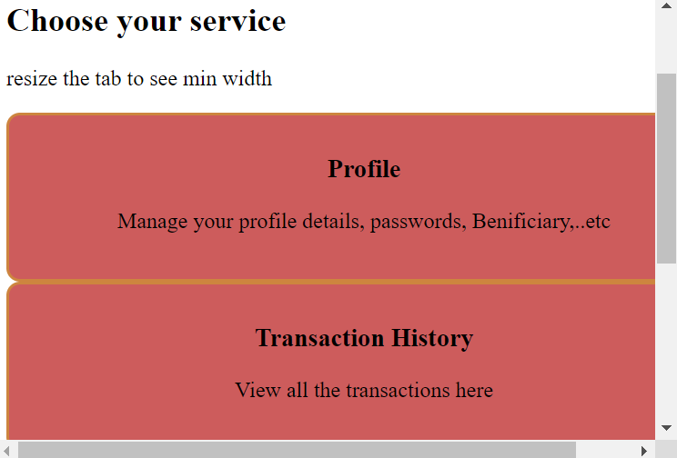
Sample output

Slide 5
Min and Max Width implementation
Let’s implement min and max width.

Slide 6
Summary
Min and Max width is used to set the dimensions for various html tags.
We can also do the same for Min and Max height which is very rarely used.
DO NOT WRITE ANYTHING
HERE. LEAVE THIS SPACE FOR
WEBCAM

Slide 7
Thank You
Proprietary content. ©Great Learning. All Rights Reserved. Unauthorized use or distribution prohibited

